Slide 1
Academic Year 114
ITM Internship Application Process
The internship is a key learning phase for ITM students.
It allows you to apply knowledge and gain valuable experience. This process will guide you from eligibility to performance evaluation. Please review each stage carefully to ensure successful completion.

Slide 2
Collaborative Internship Organizations
Hospitality Industry
Fullon Hotel Tamsui Fisherman’s Wharf
Le Méridien Taipei
The Grand Hotel
Kagaya
Mandarin Oriental Hotel
Regent Taipei
Taipei Marriott Hotel
Lakeshore Groupsite
Courtyard by Marriott Taipei Downtown
Grand Hyatt Taipei
Grand View Resort Beitou

Slide 3
Collaborative Internship Organizations
Travel Agencies (Not cooperate this year)
Phoenix Tours
Convention & Exhibition
HWH Executive Consultant Limited
Aviation
Plaza Premium Lounge

Slide 4
How to get Internship Credits?(Select one)
Completed 200 hours domestic internship
Completed overseas internship with a passing grade
Completed the “Tourism Industry Internship”
(3-credit required course)
Completed credit recognition for the
“Tourism Industry Internship”
Participated in the Employment Credit Program and completed a six-month internship

Slide 5
Internship Application Process
2.Application verification
and placement coordination
1.Submit internship application online
4.Contract signing prior to
internship commencement
3.Results announcement

Slide 6
Application timeline and document readiness
Apply for Summer vacation,
114-1 semester internship
Apply for Winter vacation,
114-2 semester internship
Submit internship app. online
Submit internship app. online
Application deadline: May 31, 2025 (Sat.)
Application deadline: Nov. 30, 2025 (Sun.)
Application verification
and Placement coordination
Application verification
and Placement coordination
Operation period: Early June 2025
Operation period: Early Dec. 2025
Result Announcement
Result Announcement
Expected time: Late June 2025
Expected time: Late Dec. 2025
Complete contract signing
Complete contract signing
Expected time: Before July 2025
Expected time: Before Jan. 2026

Slide 7
Documents to prepare in advance for internship application
1.One ID photo
2.One autobiography
3.Grades of each semester (Please check the School Administrative Information System
and attach a screenshot)
4.International student needs to prepare ARC and work permit

Slide 8
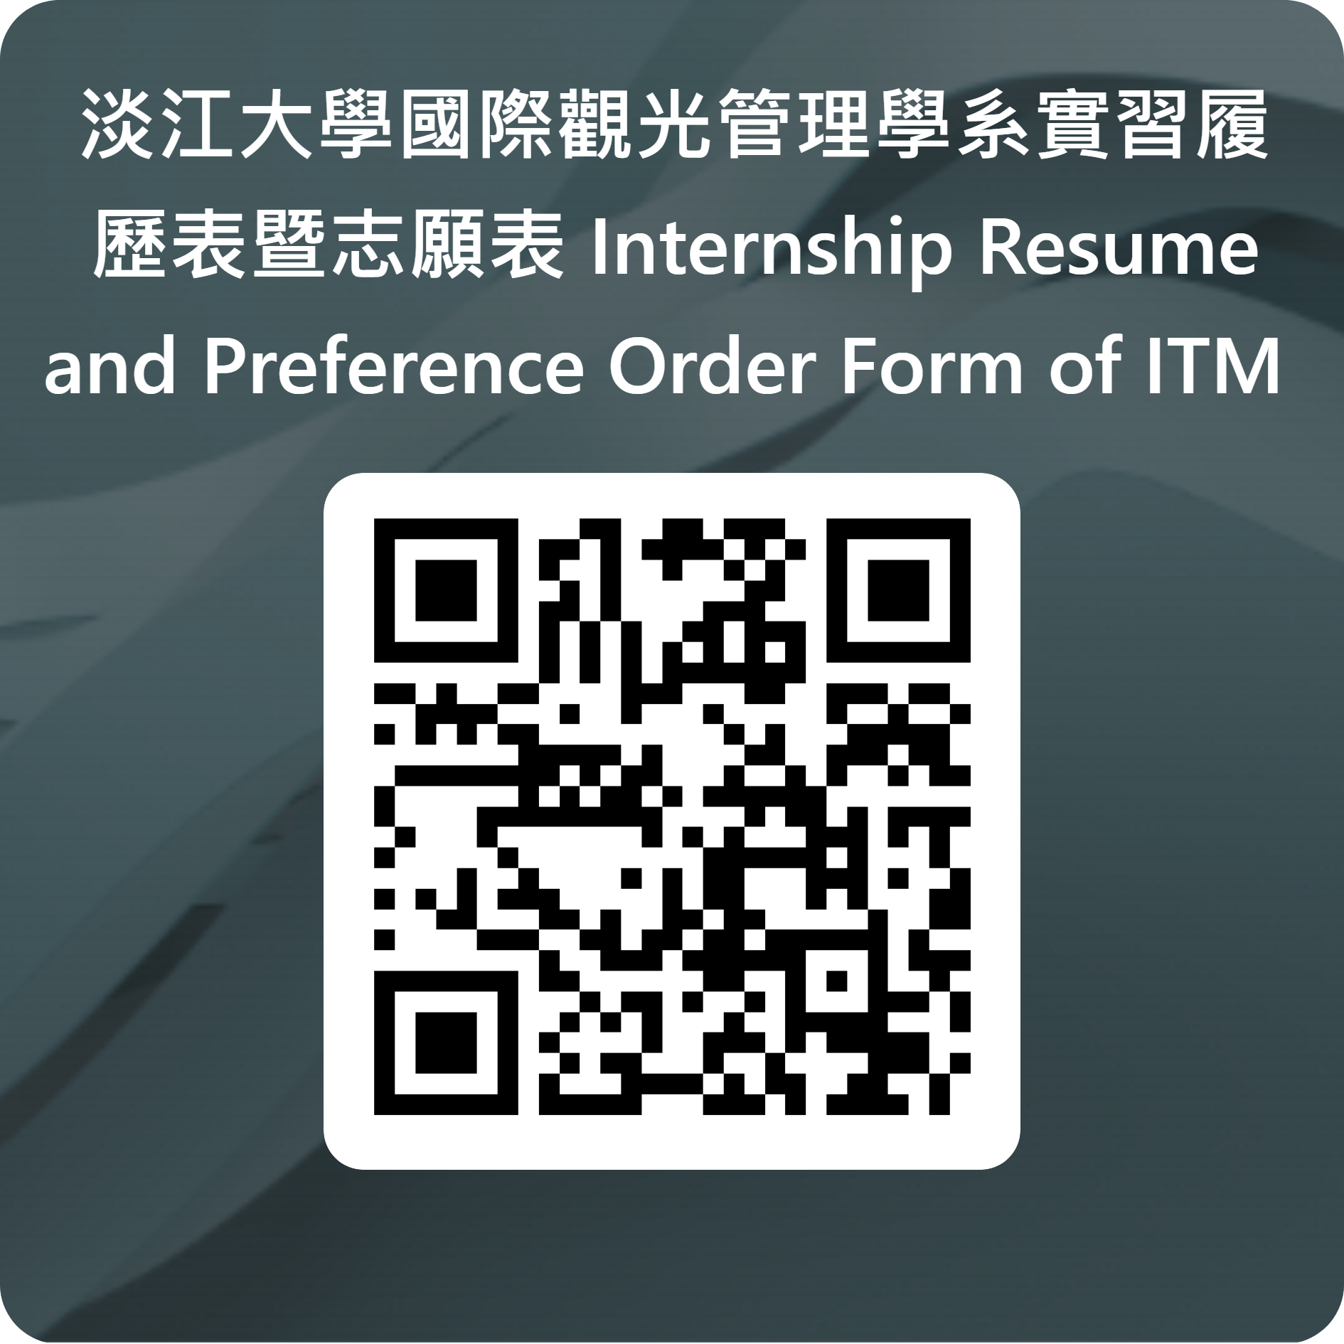
Internship Application Online Link
https://forms.office.com/r/Wv01Dq2qLg
Period for application: Summer vacation and 1st semester
System open: April 22, 2025 to May 31, 2025 (Sat.) 23:45
https://forms.office.com/r/Wv01Dq2qLg
Period for application: Winter vacation and 2nd semester
System open: Oct. 31, 2025 to Nov. 30, 2025 (Sun.) 23:45

Slide 9
Internship responsibilities and obligations
Abide by the rules
Strictly adhere to working hours, dress code, and confidentiality agreements.
Complete the internship Journals
Write 4 internship Journals, each in English with 500 words and at least 1 photo.
Distribute your learning evenly across the Journals.
Report an issue
Maintain contact with the teacher and report any difficulties in adjusting.
Submit the Evaluation form
Please have your supervisor fill out the Evaluation form
and submit it back to the school at the end of the internship.

Slide 10
Tourism Industry Internship
3 mandatory credits in the second semester of the senior year
Pass the internship Evaluation, and complete the internship sharing in class
Submit all internship documents (contract, journals, evaluation form)
Complete all the above to pass the course

Slide 11
Employment Credit Program (6-month internship)
Eligibility Requirements
1.Students in the junior year(inclusive) or above
2.Students with an overall score of
70 or above in their first and second years
Application Timeline
Submit application in October
Complete interview &confirm placement in November
Submit the list to Academic Affairs in December
For more details, please refer to
the department's official website

Slide 12
Q&A
1. Q：Can I find an internship on my own in the future?
A：No, you can't get approval immediately like we used to do. You’ll need to go through the
internal review process, which takes at least six months to a year.
2. Q：Can I apply for the Employment Credit Program after completing an overseas internship?
A：Yes, you can. As long as you submit the required documents within the specified timeline.
3. Q：Do I submit paper or electronic copies of internship documents?
A：Submit paper copies and provide electronic files of the journal photos.

Slide 13
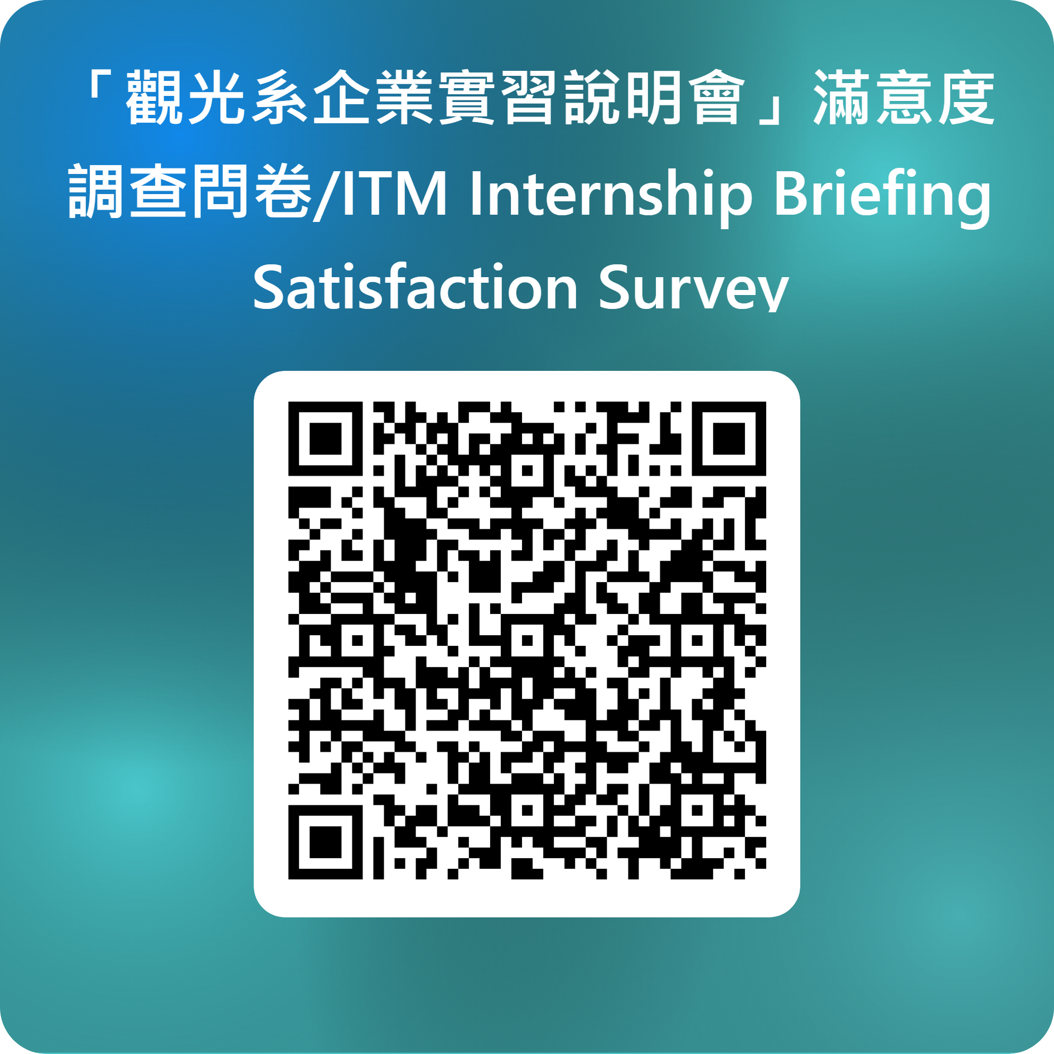
Thank you！

